Slide 1
MOLECULAR BASIS OF INHERITANCE
Chapter -6

Slide 2
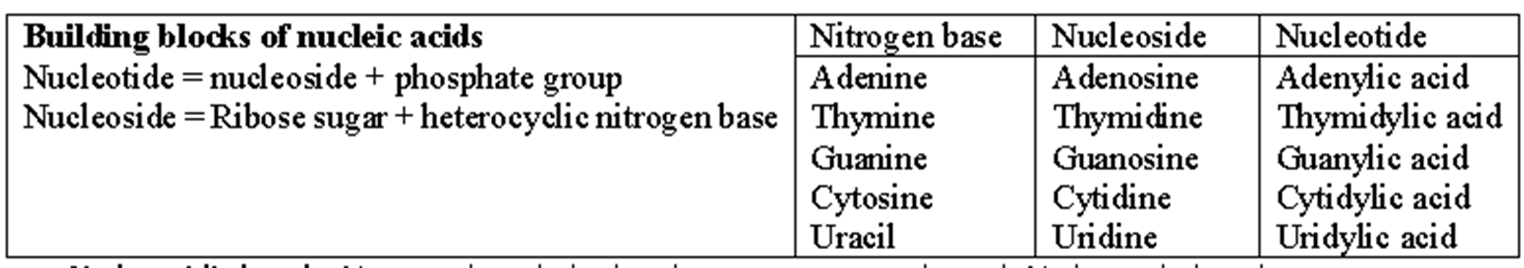
NUCLEIC ACIDS
Nucleic acids are polynucleotides. Nucleotides are the building blocks.
Nucleotides contain
a. Heterocyclic nitrogen containing compound – Purines (Adenine & Guanine) & Pyrimidines (Thymine,
Uracil & Cytosine).
b. Pentose Sugar - Ribose in RNA & Deoxyribose in DNA.
c. Phosphoric acid.

Slide 3
N-glycosidic bond – Nitrogen base linked to the pentose sugar through N-glycosidic bond.
Phosphodiester bond- The bond between the two nucleotide is called phosphodiester bond.
DNA and RNA has 2 ends
• a phosphate group remains free at 5′ end of ribose sugar called 5′end
• an -OH group remains free at 3′ end of ribose called 3′ end

Slide 4
Double Helix Structure of DNA
James Watson and Francis Crick in 1953 proposed double helix structure model for DNA based on the X-ray diffraction data by Wilkins and Franklin and base pairing rule by Erwin Chargaff.
Double helix structure
DNA has two polynucleotide chains and are coiled like a helix called double helix.
Sugar-phosphate forms the backbone of this helix.
The bases in two strands are paired -Purines always pair with their corresponding pyrimidines.
Adenine pairs with Thymine through two hydrogen bonds.
Guanine pairs with Cytosine through three hydrogen bonds.
The double helix is right-handed. The pitch of the helix is 3.4 nm.
The two chains have anti-parallel polarity i.e. one chain has the polarity 5’→3’ and the other has 3’→5’.

Slide 5
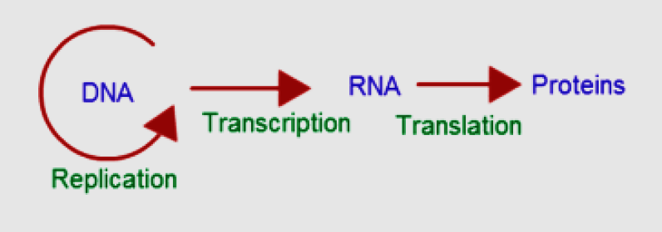
THE CENTRAL DOGMA
The flow of information from DNA to protein through RNA is known as central dogma. Central dogma in molecular biology is proposed by Francis Crick.

Slide 6
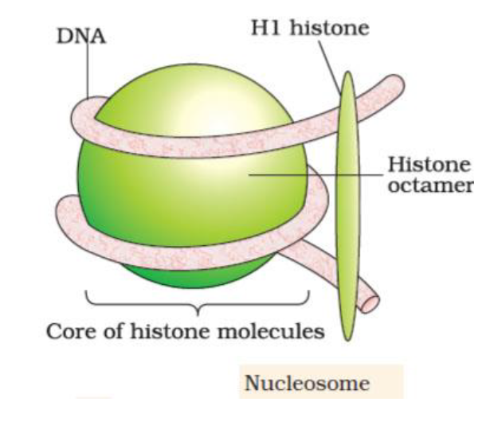
Structure of Nucleosome
The basic repeating units in the structure of chromatin is called nucleosome.
A typical nucleosome contain 200 base pairs of DNA helix.
Each nucleosome contain histone proteins and DNA strand.
Histones are organised to form a unit of eight molecule called histone octamer.
The negatively charged DNA wrap around the histone octamer.
The histone protein namely H1 histone bind externally to the wrapped DNA.
The nucleosome in chromatin has a bead-on-string like structure .
Euchromatin – Loosely packed and less stained region of chromatin is called euchromatin.
Heterochromatin – More densely packed and dark stained region of chromatin is called heterochromatin.

Slide 7
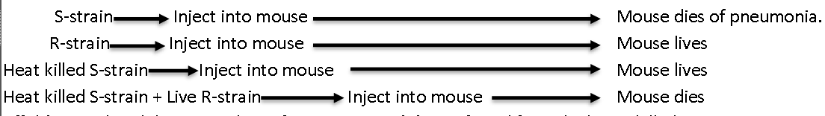
Search for Genetic Material-Transforming Principle.
Frederick Griffith’s experiments with the bacteria Streptococcus pneumoniae (Pneumococcus).
This bacterium has two strains
S strain (smooth strain/Virulent) : Has mucopolysaccharide coat that cause Pneumonia.
R strain (rough strain/Non-virulent) : Mucous coat absent and did not cause Pneumonia.
Steps in Griffith’s experiment
Griffith’s postulated that some ‘transforming principle’ transferred from the heat- killed S-strain to R-strain and make them virulent.
Oswald Avery, Colin MacLeod and Maclyn McCarty experimentally proved that transforming principle is DNA

Slide 8
Hershey-Chase Experiment
Hershey and Chase worked on bacteriophages. They produce two colonies of bacteriophages.
First colony grown in a medium containing radioactive sulphur (35S) their protein capsid labelled with 35S.
Second colony grown in a medium containing radioactive Phosphorous (32P) their DNA labelled with 32P.
These radioactive phages were used to infect E. coli.
After the infection E.coli was blended and centrifuged to remove viral particles.
It was observed that bacteria with radioactive DNA were infected by phage with radioactive (labelled with 32P) DNA, while those with non-radioactivity were infected by phage with radioactive (labelled with 35S) protein capsid .
This showed that it is the DNA that enters the bacteria from viruses and not proteins. This proves that DNA is the genetic material.

Slide 9
DNA replication Machinery and the enzymes
Synthesis of new DNA from the parental DNA is called replication.
Since the newly synthesised DNA have one parental and one newly synthesised DNA, this type of replication is called semiconservative DNA replication.
What is semiconservative DNA replication?

Slide 10
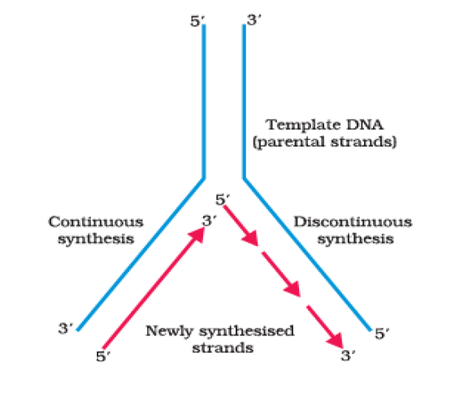
Semiconservative DNA replication.
DNA dependent DNA polymerase :-
The main enzyme involved in semiconservative DNA replication.
The enzyme that catalyse the polymerisation of deoxyribonucleotides.
It catalyse the polymerisation of DNA in 5’ – 3’ direction only.
Replication fork
Small regions of parent DNA from where the replication start is called replication fork.
Continuous Synthesis
The template or parental DNA strand with polarity 3’ – 5’ undergo continuous synthesis.
In this strand new strand is produced towards the replication fork in 5’ - 3’ direction.
Discontinuous Synthesis
The template or parental DNA strand with polarity 5’ – 3’ undergo discontinuous synthesis.
In this strand new strand is produced away from the replication fork in 5’ - 3’ direction.
New DNA strands are formed as short pieces in discontinuous synthesis.
DNA Ligases
The short piece of DNA produced through discontinuous synthesis are joined by DNA ligases.
Origin of Replication
The region of the DNA in bacterial cell where replication start is called origin of replication

